Slide 1
Computer vision practical assignment Group - G
BY : Tuo Yang(589715)
Yordanos Alemu(0592896)
Subhashree Rautray(0592964)

Slide 2
Camera calibration
For caliberation task we need the world frame coordinates and their correspoding pixel coordinates.
For this task we can do it by finding the corner point coordinates of cubes present in the image frame and the 3D mass center given in txt file.
Then we can find the projection matrix by using the pixel coordinates and the world coordinates.

Slide 3
Back-projection
Here we need to find the 3D locations of blocks .
For this we need to find the mass center pixel coordinates of cubes by performing segmentation to the images.
Segmentation can be done by color thresholding using RGB,HSV color spaces.
After that we need to find the mass center using regionprops of matlab predefine function.
Decomposition to the projection matrix to get K,R ,C .
Use pixel coordinate and K,R,C matrix to get the world coordinate.

Slide 4
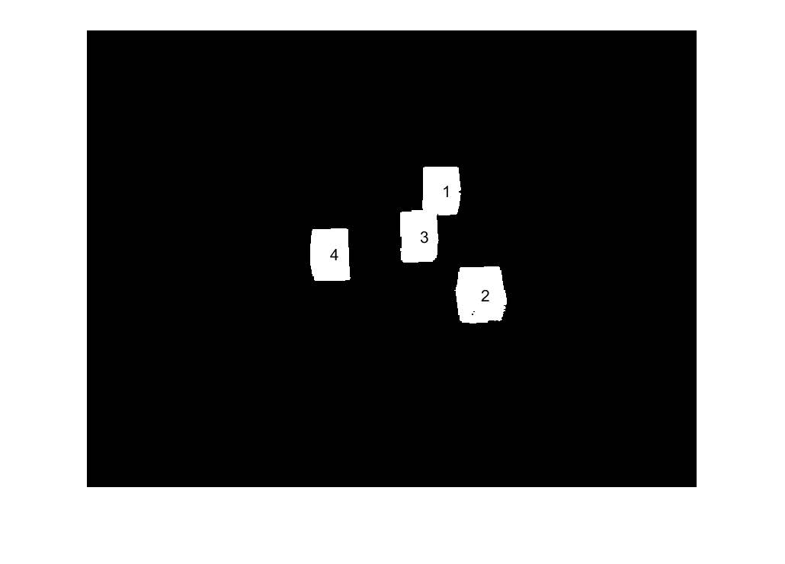

Segmentation Results
8130478-2021-04-07-100538-l.png
8130478-2021-04-07-100538-r.png

Slide 5
Robotics Control
In this step we have taken the 3D mass centers of world frame given in the 3rd set of images to do the projection and back-projection for localising the cubes in the world frame .
After the process mentioned above,we need to use localised mass center coordinates to find their corresponding coordinates in the robotic frame .
For this we will define the transformation matrix ,it includes two elements which are rotation matrix ’R’ and translation vector ’T’.
Using the rotation matrix ,translation vector,world coordinates to get the coordinates in the robotics frame.

Slide 6
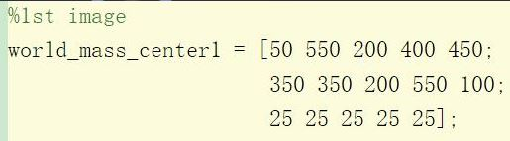
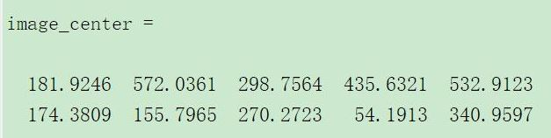
Output

Slide 7
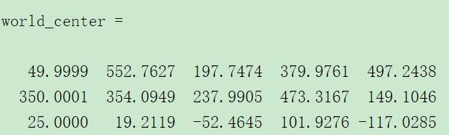
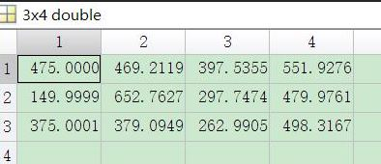
Output

